Slide 4
CPU Time
Avg time
30 Tests
Array size = 10mil
Clock_t clock()
Cpu gain = (2106.73-1447.9)/2106.73 = 31.27%

Slide 5
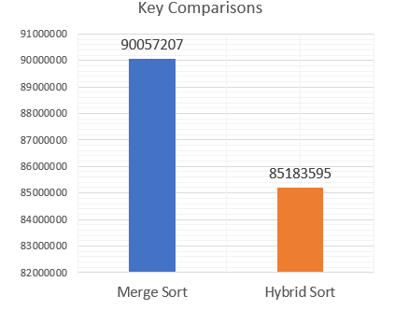
Key Comparison
Avg key comparisons
30 Tests
Array size = 10mil
% decrease = 5.41%

Slide 6
Pseudo code
#define ARRAY_SIZE //Maximum array size
#define TESTS //No. of tests to run on each array size
#define MAX //Maximum number in array
#define THRESHOLD //S value
Int main(){
int *array = malloc() //Allocate memory on heap
for(i=start_size; i <= ARRAY_SIZE; i++{
start = clock()
for(test=0; test < TESTS; test++){
generateArray(test, array); //Generates #test size array with rng
SortingAlgorithm(array); //Includes key comparison
}
end = clock()
store_times[i] = (end-start)/TESTS; //Avg of all the tests
store_keycmp[i] = key_cmp/TESTS; //Avg of all tests
}
}

Slide 7
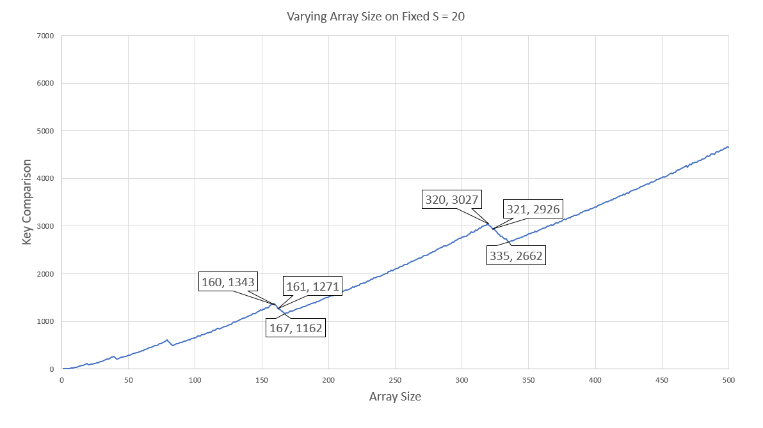
Use.

Slide 8
Use.

Slide 9
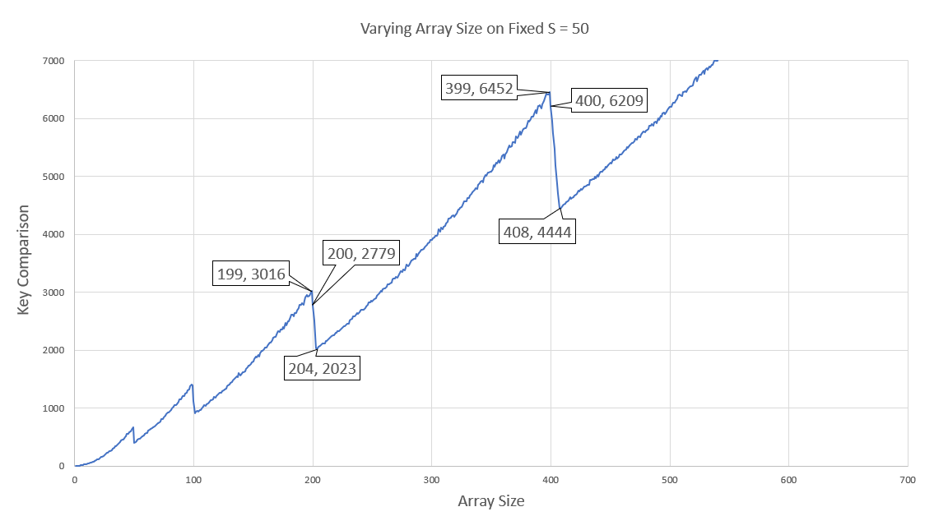
Use.

Slide 10
use

Slide 11
